Slide 1

MACHINE LEARNING AS A SERVICE
INFO7390 15974 Advances Data Sci/Architecture
By
Abhinav Tiwari
Dharit Shah
Nilesh Nerkar
(Team 2)

Slide 2
Agenda
Machine Learning Pipeline
Machine Learning as a Service
How MLaaS makes it easy?
Available Machine Learning Services
Azure ML Studio
What is Amazon SageMaker?
BigML & AutoML

Slide 3
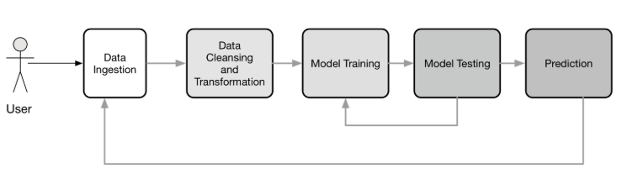
MACHINE LEARNING PIPELINE

Slide 4
Machine Learning As A Service
The same as SaaS or BaaS solutions, machine learning as a service platforms are intended to handle nearly all matters connected with infrastructure
Developers are not obligated to messing with model training and evaluation, as well as worry about further cloud-based predictions
MLaaS makes it easy and automate the pipeline depending upon the service which we use

Slide 5
Available Machine Learning Services
Azure Machine Learning
Amazon Machine Learning
H2O AI
BigML
Databricks
Google Prediction API
IBM Watson

Slide 6
What is Azure ML Studio?
There are basically two Azure ML services:
Azure ML Workbench and Azure ML Studio
Azure ML Studio appears to have a more fully-featured GUI and user-friendly deployment tools, whereas Workbench appears to have more powerful / customizable deployment tools
Azure ML Studio has a hard limit of 10 GB total input of training data per module, whereas Workbench has a variable limit by price

Slide 7
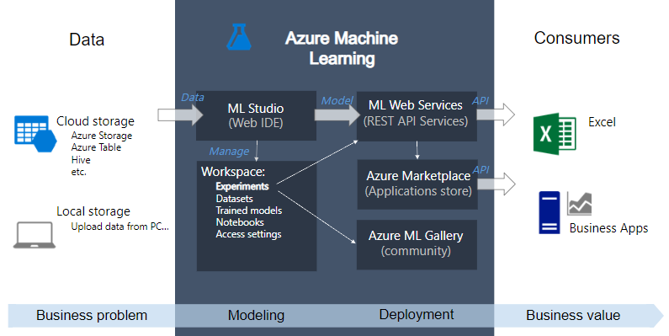
Overview Azure ML Studio

Slide 8
Azure ML Studio Demo
Regression on Appliances Energy Dataset
To predict the appliances energy a house
Classification on Titanic Data Set
To predict the chance of Survival
Classification on Titanic Data Set
To predict if the airplane will be delayed by 15 mins

Slide 9
Pros and Cons of Azure ML Studio
Following are some of the advantages of Azure ML Studio:
No Software to install, only web browser is needed
Possibility to develop without writing code
Easy deployment and usage using Rest API
Following are some of the disadvantages of Azure ML Studio:
Maximum dataset volume is 10 GB per module
The default endpoint is provisioned with 20 concurrent RRS requests per endpoint. You can scale this to 200 concurrent requests per endpoint, and you can scale each web service to 10,000 endpoints per web service
Its like a Black Box, no debug, no Scala, C++, C#
One should know their own right algorithm to be used

Slide 10

Amazon Machine Learning (Sagemaker And Machine Learning)

Slide 11
What is Amazon Sagemaker ?
Amazon Sagemaker is end to end machine learning platform which offers developer workbench to training process to deployment process
It gives you powerful GPU to run your model and provides different learning platform like TensorFlow ,pytorch
Hugh choice of different machine learning algorithm and Integrated Juypter Notebook
Experience of whole machine learning process in your continuous pipeline and part of automatic setup when you add data every time it will make your model better and better

Slide 12
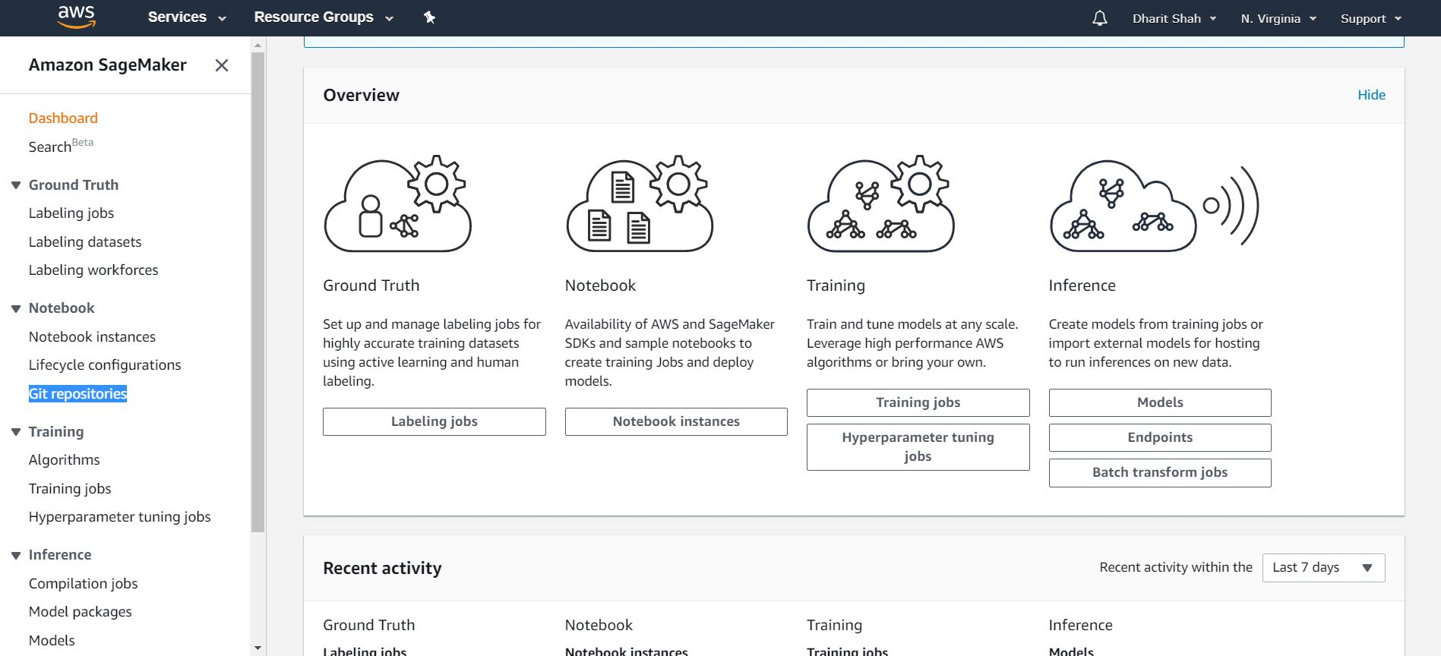
Pipeline

Slide 13
Amazon SageMaker Features
Build
Build highly accurate training datasets
Managed Notebooks for Authoring Models
Built-in, High Performance Algorithms
Broad Framework Support
Train
One-click Training
Automatic Model Tuning Broad Framework Support
Train Once, Run Anywhere
Deploy
One-click Deployment
Fully-managed Hosting with Auto Scaling

Slide 14
Amazon SageMaker Demo

Slide 15
Amazon Machine Learning
Amazon Machine Learning (Amazon ML) is a robust, cloud-based service that makes it easy for developers of all skill levels to use machine learning technology
Amazon ML provides visualization tools and wizards that guide you through the process of creating machine learning (ML) models without having to learn complex ML algorithms and technology
Once your models are ready, Amazon ML makes it easy to obtain predictions for your application using simple APIs, without having to implement custom prediction generation code, or manage any infrastructure.

Slide 16
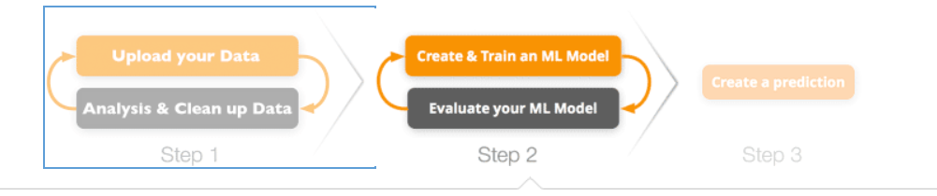
Pipeline

Slide 17
Demo

Slide 18
AutoML Services
AutoML provides methods and processes to make Machine Learning available for non-Machine Learning experts, to improve efficiency of Machine Learning and to accelerate research on Machine Learning
AutoML helps us in automating tasks whose complexity can often baffle non-ML experts, like :
Preprocess and clean the data.
Select and construct appropriate features.
Select an appropriate model family.
Optimize model hyperparameters.
Postprocess machine learning models.
Critically analyze the results obtained.

Slide 19
H2O AI
Overview :
H2O is an open-source software for big-data analysis.
H2O allows users to fit thousands of potential models as part of discovering patterns in data.
Salient Features :
It automates the model selection and validation process in the Machine Learning pipeline through its AutoML framework.
H2O is built on top of the Hadoop distributed framework, thereby enabling faster data processing on its clusters.
It also has functions for exporting the trained models as JAVA POJO’s for productionizing the model once it has been validated.

Slide 20
H2O AI DEMO
Regression on Iowa Housing Price Data Set
To predict the SalePrice of the house
Classification on Titanic Data Set
To predict the chance of Survival

Slide 21
BigML
Overview :
BigML is MLaaS, which provides robustly-engineered Machine Learning algorithms proven to solve real world problems, through a simple and elegant web interface.
Features :
Like H2o it provides an OptiML library for AutoML pupose.
It is platform independent i.e. it can access data from AWS, Google Drive, etc.
The Web UI is extremely intuitive and easy to use.
The models are very interpretable

Slide 22
BigML DEMO
Regression on Iowa Housing Price Data Set
To predict the SalePrice of the house
Classification on Titanic Data Set
To predict the chance of Survival

Slide 23
BigML DEMO
Regression on Iowa Housing Price Data Set
To predict the SalePrice of the house
Classification on Titanic Data Set
To predict the chance of Survival

